Slide 1
IRAD - Cloud Computing Data Processing (CCDP)
^{Oscar E. Ganteaume}
^{May 2017}

Slide 2
Motivations
Current frameworks rely on pre-existing cluster
Fixed resource allocation limits a system
Ensuring capacity for peak processing can incur higher costs
Lowering costs by decreasing resources can impede system’s performance
APIs are now available to start and stop resources dynamically

Slide 3
Approach
Create a framework for dynamic resource allocation
Allow for decision making interfaces to determine when to start or stop resources
Provide a flexible way to execute tasks on a cluster
  Run a thread in parallel or sequentially
  Run a task on a dedicated virtual machine
  Run tasks based on least used VM based on memory and CPU utilization
  Run tasks based on first-fit
Allow different types of virtual machines to be launched
Allow developers to add their own processing modules
Provide feedback on running tasks

Slide 4
Open Source Resources
Docker Container: Platform that allows to package applications in “containers” making them portable
NiFi: Automates the flow of data between system and provides modules for data manipulation
Machine Learning: Provides computers the ability to learn without being explicitly programmed
  SciKit-Learn
  Shogun
  ConvNetJS
Big Data Analytics: The process of examining large and varied data sets to uncover hidden patterns
  Spark
  Hadoop
  Cloudera

Slide 5
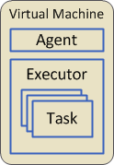
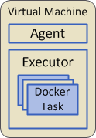
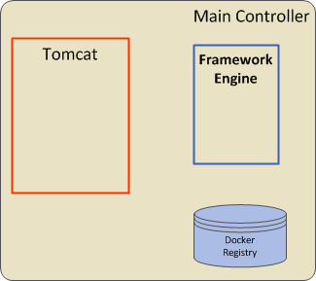






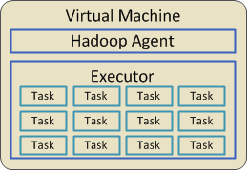
Processing Framework

Slide 6
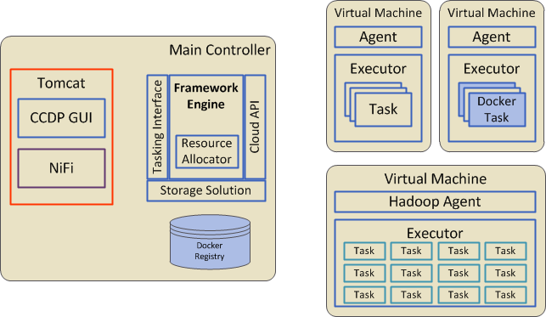
Questions?

